Slide 1

Experiences in implementing European Services using national INSPIRE services Data Provider (LMO) perspective
Eva Pauknerová

Slide 2
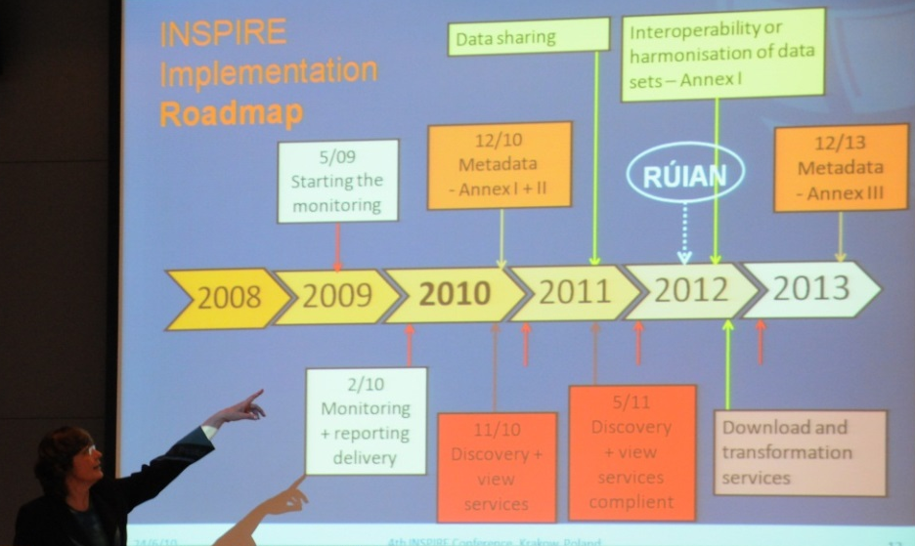

Presentation outline
roles and products
from local to national data
from national to European SDIs
and return
Lessons learned

Slide 3
CUZK perspective
CUZK (NMCA) maintains and provides most of reference and base geospatial data in the Czech Republic, both - administrative and topographic.
CUZK is NOT a MS-CP for INSPIRE, but it plays a significant role at the national coordination body for INSPIRE implementation – KOVIN.
CUZK set up and administers the Base Registry of Territorial Identification, Addresses and Real Estates – RUIAN
its content up-dated in accord with the O-O-P by authorized editors daily; for eGovernment available 24/7
RUIAN accelerated the INSPIRE implementation already in 2010,
bridging RUIAN and INSPIRE illustrates potential and limits of INSPIRE for eGovernment.
As a member of EuroGeographics (EG), CUZK participated in European projects as the European Location Framework and OELS; it contributes to various EG Products as ERM, EGM, EGN, CRD etc.
The ELF and OELS projects, esp. the CZ-PL regional pilots helped detecting several cross-border data harmonisation issues and invoked various follow-up actions:
by EG, by and between NMCAs, and with other stakeholders at the MSs.

Slide 4
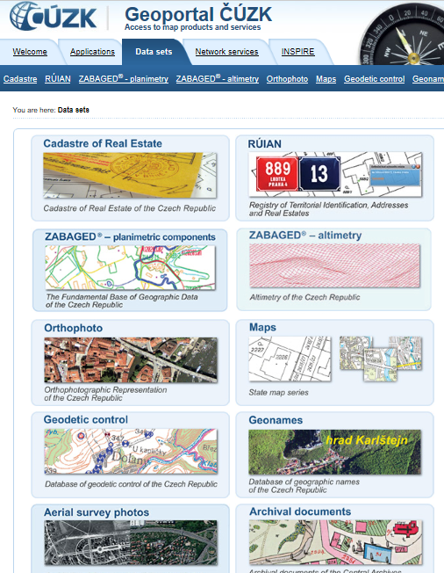
Czech Office for Surveying, Mapping and Cadastre
Key information sources:
ISKN - Information System of the Cadastre of Real Estates
RUIAN - the Base Registry of Territorial Identification, Addresses and Real Estates
ZABAGED - the Fundamental Base of Geographic Data of the Czech Republic
CUZK Geoportal http://geoportal.cuzk.cz

Slide 5



Goals: Data maintenance at one place and sharing across different levels …
Local data, survey sketches
INSPIRE data sets (AD, AU, CP, GN, BU etc)
INSPIRE webservices (WMS, WFS, Atom etc)
location data used by PAs at the EU+
Location data in Czech Base Registries (RÚIAN)
Feasible ?

Slide 6
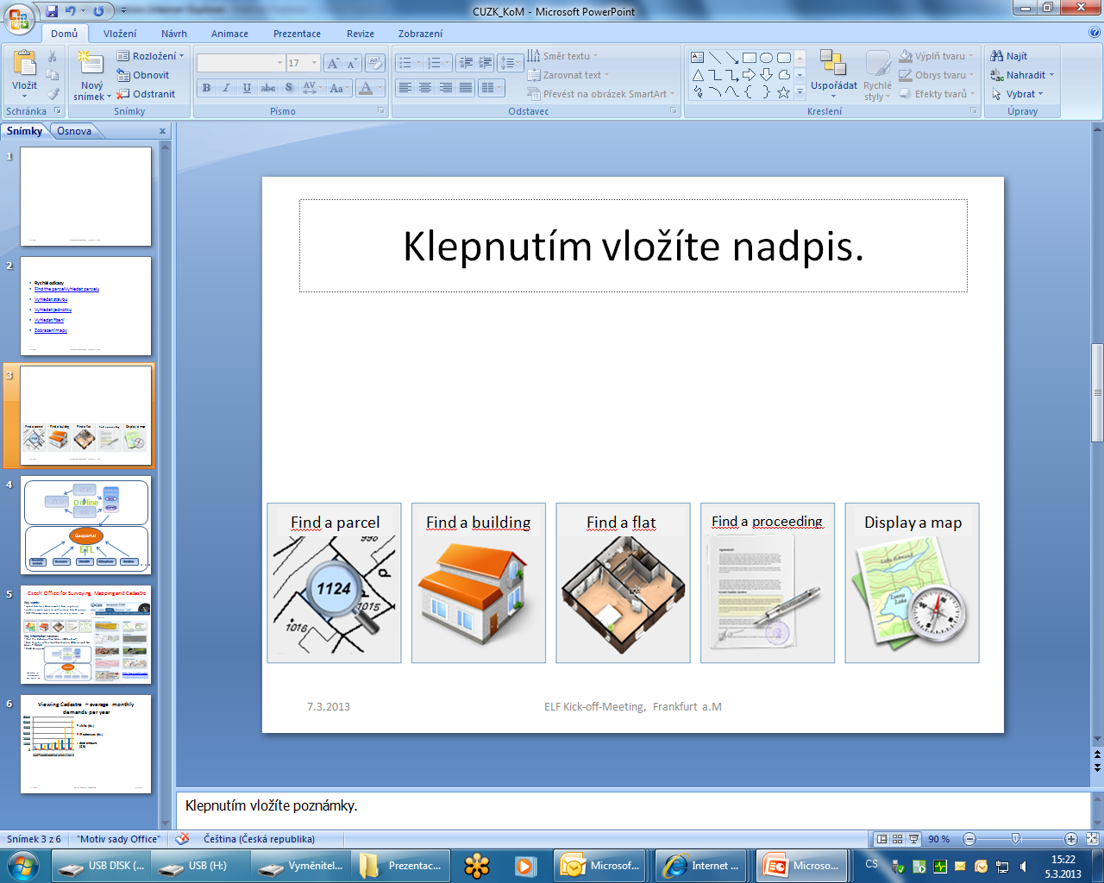
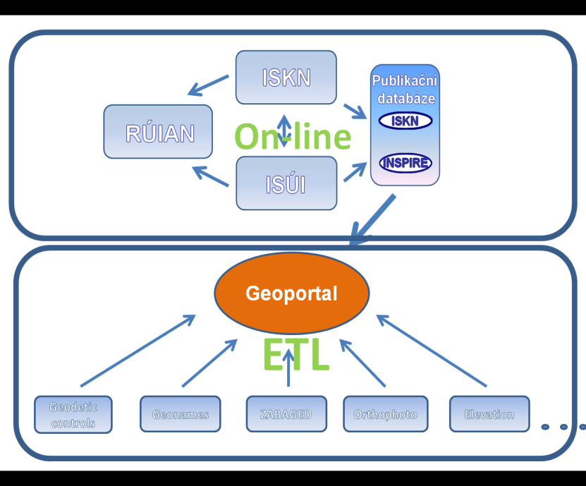
Czech Office for Surveying, Mapping and Cadastre
Key words:
public on-line access to authoritative data&services
up-to-date location data for base registries and e-Government; open location data for re-use
Two modes of reaching compliance with IIRs and of provision conditions
INSPIRE compliance:
CP, AU, AD, BU, GN, HY, TN, GG, EL, OI

Slide 7
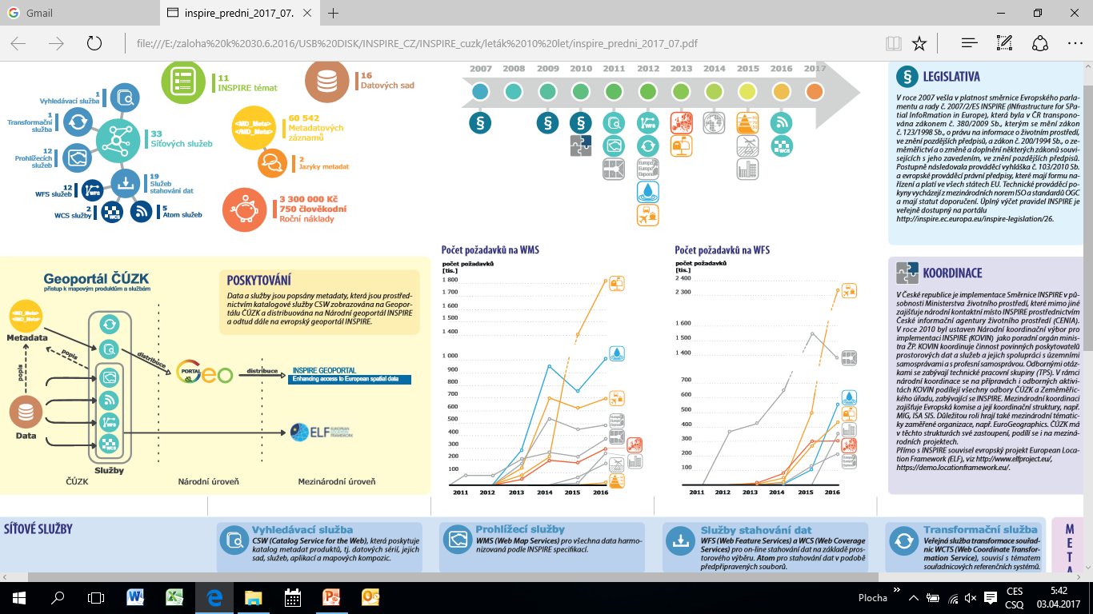
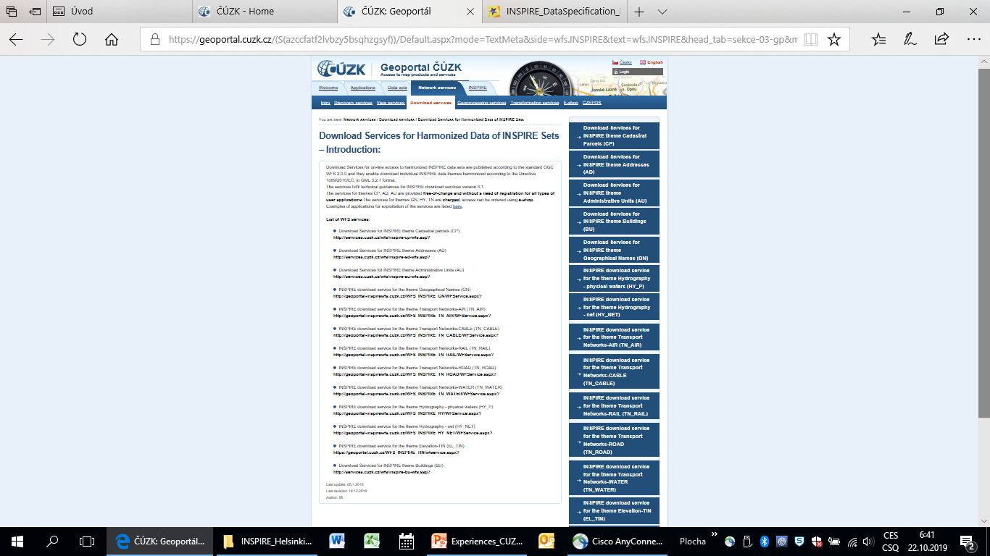

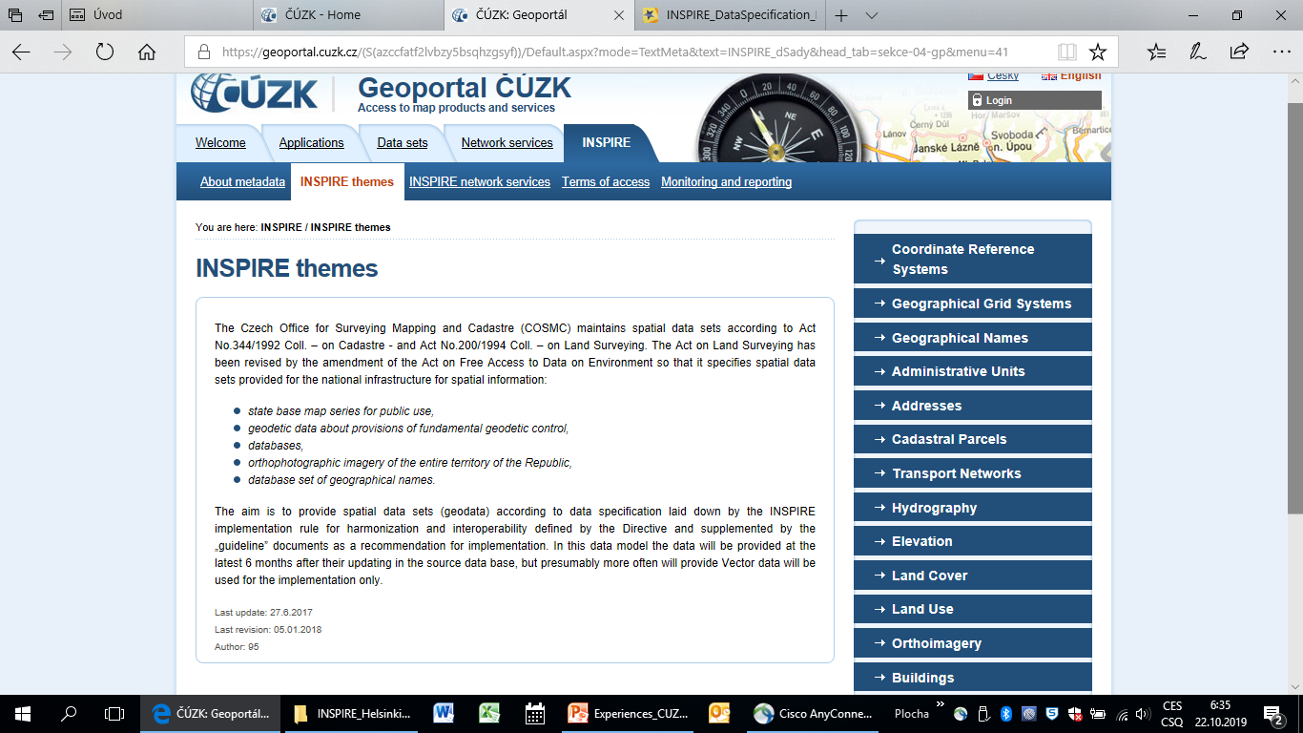
Data provision
INSPIRE Data provision
National level
International level

Slide 8
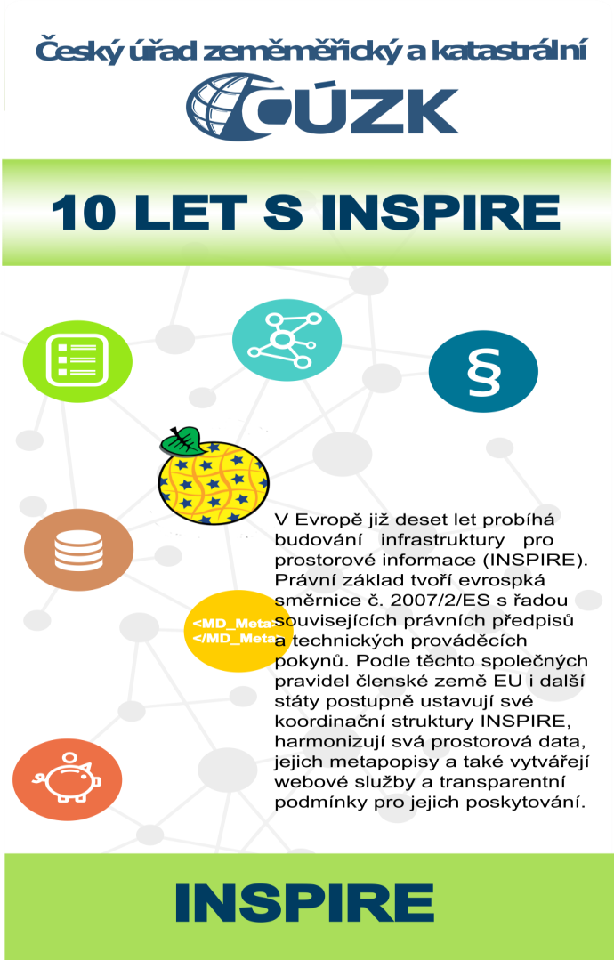

10 YEARS with

Slide 9
Quality and interoperability enhancement
- a never ending story due to new standardisation or legal changes, ICT innovation etc;
- capacities and efficient communication of several types of stakeholders needed to reach interoperable results (providers of data, specifications and also of ICT and testing tools)
MD and/or data revisions
INSPIRE/ELF datasets up-dates
INSPIRE/ELF services updates (WMS, WFS etc)
Testing, revisions …

Slide 10
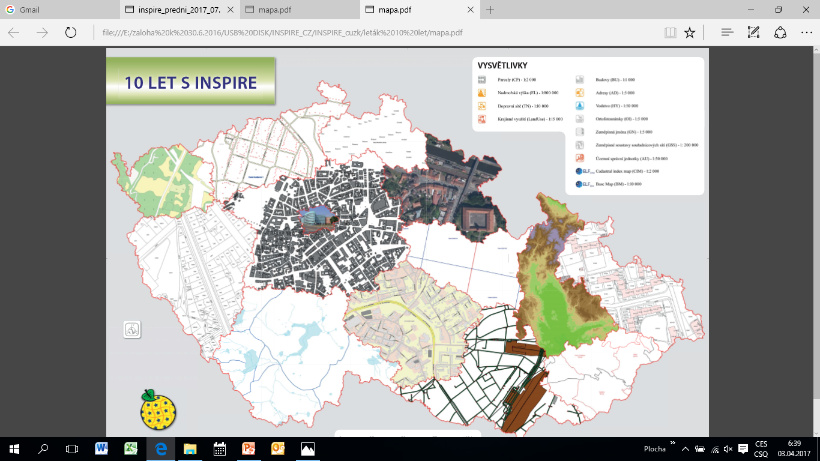
10+ years with INSPIRE, 5 years with ELF

Slide 11
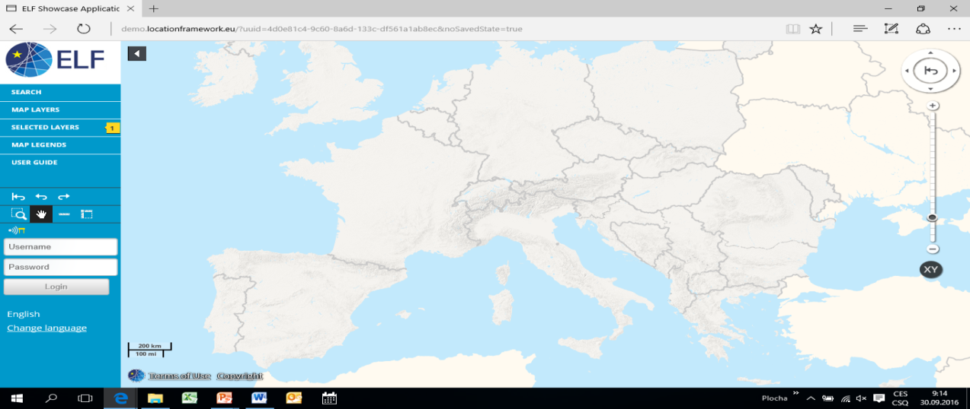
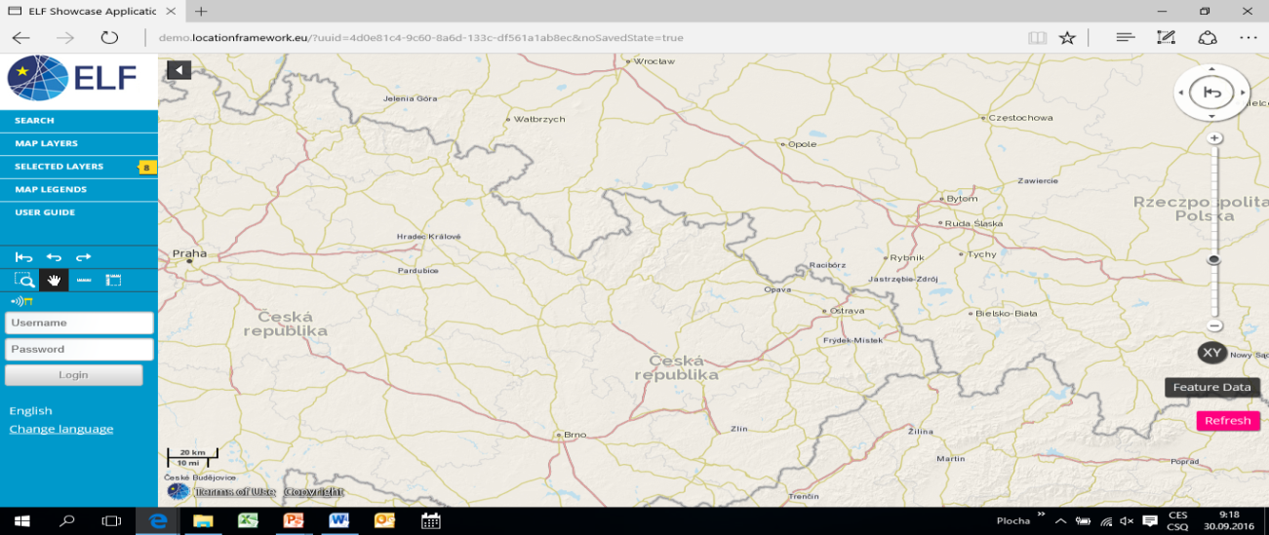

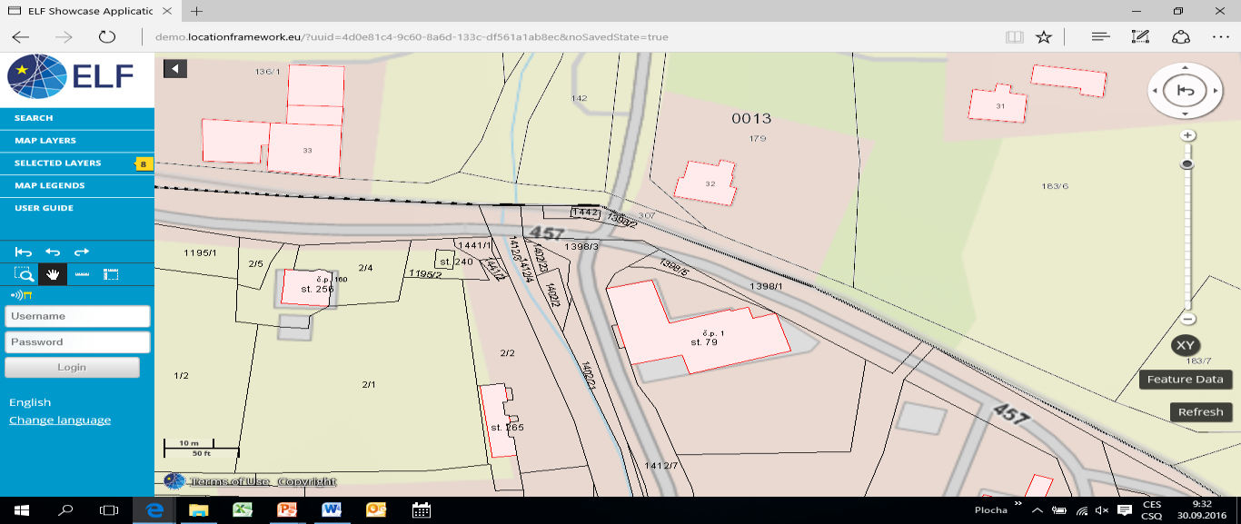
From national to EUropean
CZ - PL
Cluster approach
Prototype testing,
e.g.
Cadastral Index Map
CZ - PL

Slide 12
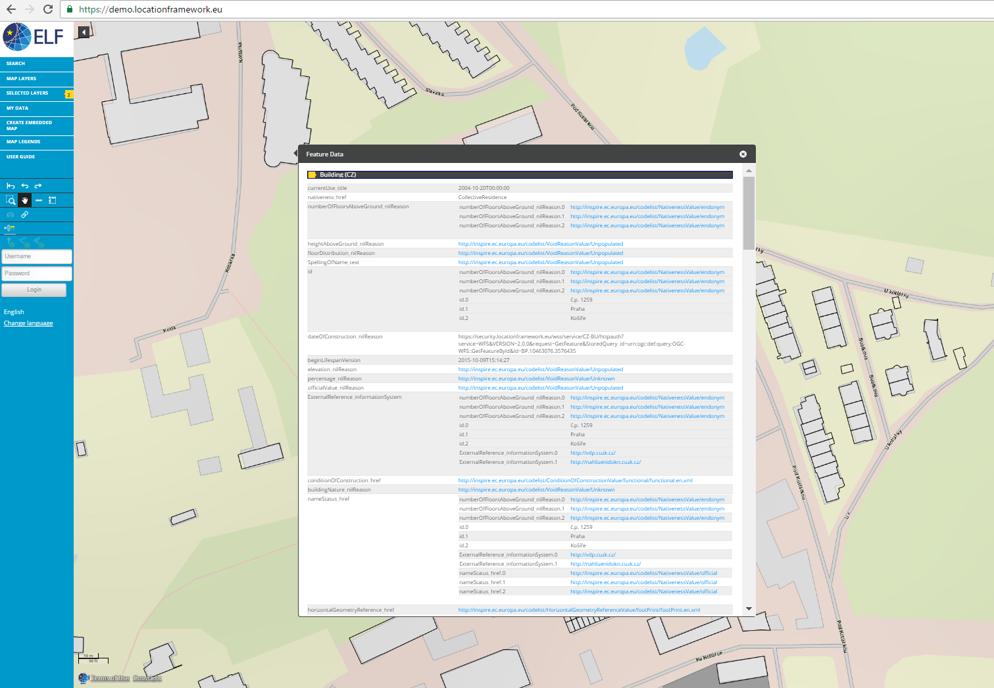
Success: Up-to-date authoritative location data (LoD0) became an integral part of the cross-border cadastral index map (or future ESDI)

Slide 13


Survey sketches, decisions by local authorities
Base Registers Data (RÚIAN edited by ISKN, ISÚI)
INSPIRE compliant data sets and services
National webservices for the ELF
Pilot cross-border analyses and testing of data sets and services
Seamless ELF data sets and services for EU+ (via an EU platform ?)
Cross-border data harmonisation (activated at all EIF levels)
Thematic applications for European Regions and the EU+

Slide 14
Data harmonisation at state borders – new requests !
Local data, survey sketches
RÚIAN and ZABAGED source data
INSPIRE data sets and services
National ELF webservices
Seamless cross-border datasets and services (incl LoD 0) ?!?
Testing and data enhancement
Revision of the process and calculation as regards ETRS 89 transformation
Data C-B harmonisation
- analyses, edge-matching
CPs jointly agreed for ETRS89 (to be incorported into source DBs of both MSs)
Technical up-dates of border lines incorporated into state boundary documentations
Amendments of SB documentation (to be) formally approved by both MSs = new stakeholders
The AU up-dating process to consider the SB amendments

Slide 15
Data harmonisation - data provider (LMO) perspective
Data mapping has a strong legal context – from semantics, competences, processes; not just a technical excercise.
Data sources for national use integrate several themes in a consistent manner, their maintainance is supported by robust ICT infrastructures etc.
INSPIRE cut data into themes; INSPIRE datasets etc represent new products (and capacities needed). Thematic datasets enable to understand data from other MSs, provide inputs for production of new simplified cross-border data for newly designed services (e.g. the CIM).
Temporal quality and legal validity is a key for some eGov tasks; the Base Registries deal with continuous changes and quarant reliable up-dates. Better change management is required for some of the INSPIRE themes.
Harmonizing all data goes against the O-O-P therefore focus on datasets relevant for international use and on ensuring their quality.
Solving state boundary issues and related GRSs transformation etc goes far beyond INSPIRE. (Systematic arrangements in progress with all neighbour MSs of CZ since the ELF.)

Slide 16
Lessons learned 1
INSPIRE provides useful tools (legal, coordination etc) to invoke and underpin NSDIs and ESDI development;
but it is not a one-way linear development;
The implementation provides lessons and detects existing limits:
fulfilling of some principles as seamless requires further efforts, stakeholders and time - beyond the original INSPIRE outline;
the infrastructure needs a sustainable maintainance and innovation,
a coordinated cooperation of many stakeholders (including new ones) inside MSs, EC and cross-border partners will still be needed to develop functional products for public administrations across the EU;
To build up and administer a stable, sustainable infrastructure to underpin public administration services and decision-making across the whole EU+ remains a challenge. (It reminds on the situation at MSs 15-20 years ago.)

Slide 17
Lessons learned 2
EuroGeographics (EC) enables several forms of communication and collaboration of NMCAs and their experts:
KENs (knowledge exchange networks),
Pilot projects with focus on interoperability, where NMCAs as participants can share experiences, contribute to developing and testing prototypes of new products, and provide mutual support to some extent.
Despite trials neither EG (as a professional thematuc NGO) or its members can provide (due to their status, limiting competences or budgets) a technically stable and economically sustainable infrastructure for pan-EU+ location services to underpin future cross-border administrative procedures and decision-making at the EU.

Slide 18
Lessons learned 3
Specific decisions of public administrations and services at the EU MSs rely on authoritative location data (and strictly defined processes for related editing, decision making and access required at national and local levels).
The current tendency of some EC bodies to use information products underestimating authoritative location data (and related rules) may provide misleading decisions (even if based on out-dated open data). A differentiation of information purposes and relevant information products and services is needed to avoid undermining of subsidiarity principles. The issue requires awareness raising, serious debate and new solution(s).
Reaching a consistency between topographic and administrative data concerning border-lines requires a range of systematic works (technical arrangements need to be supported by inter-ministerial communication, legal or methodical up-dates, awareness raising etc.)

Slide 19
What was the impact of ELF and INSPIRE?
INSPIRE provides or reinforces:
ELF supported and tested:
A joint legal basis for the ESDI
Coordination structures at (sub)national and EU levels
A broad use of standardized metadata > easier search for geodata and related services
Provision of interoperable webservices to discover, view and download existing sets of spatial data
Common rules to harmonize thematic data across EU+
ELISE links INSPIRE with ISA² and eGov.
A number of practical situations had not been recognized during the INSPIRE planning period or did not exist before.
Implementation of INSPIRE by NMCAs through a coordinated effort, sharing experiences, testing, ELF specifications and tools; feed-back,
Cross-border and pan-European aspects via comparison, detecting issues, developing new products.
Functional prototype components: topoBM, cadastral index map, gazeteer (with use of MSs‘ data/services)
ELF platform - a prototype one-access point to authoritative, interoperable services and data for thematic applications: cross border (and in EU+); BUT it illustrated:
the 3-years were not enough for a seamless data coverage and interoperable services for the whole of EU+ (due to several reasons).
The pilot project approach not suitable to develop and set up an ESDI requiring a central ICT infrastructure ect

Slide 20
Questions? Thanks for your attention.
Eva.Pauknerova@cuzk.cz
http://geoportal.cuzk.cz
http://inspire.gov.cz/

Slide 21
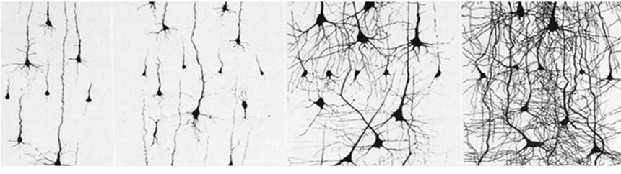
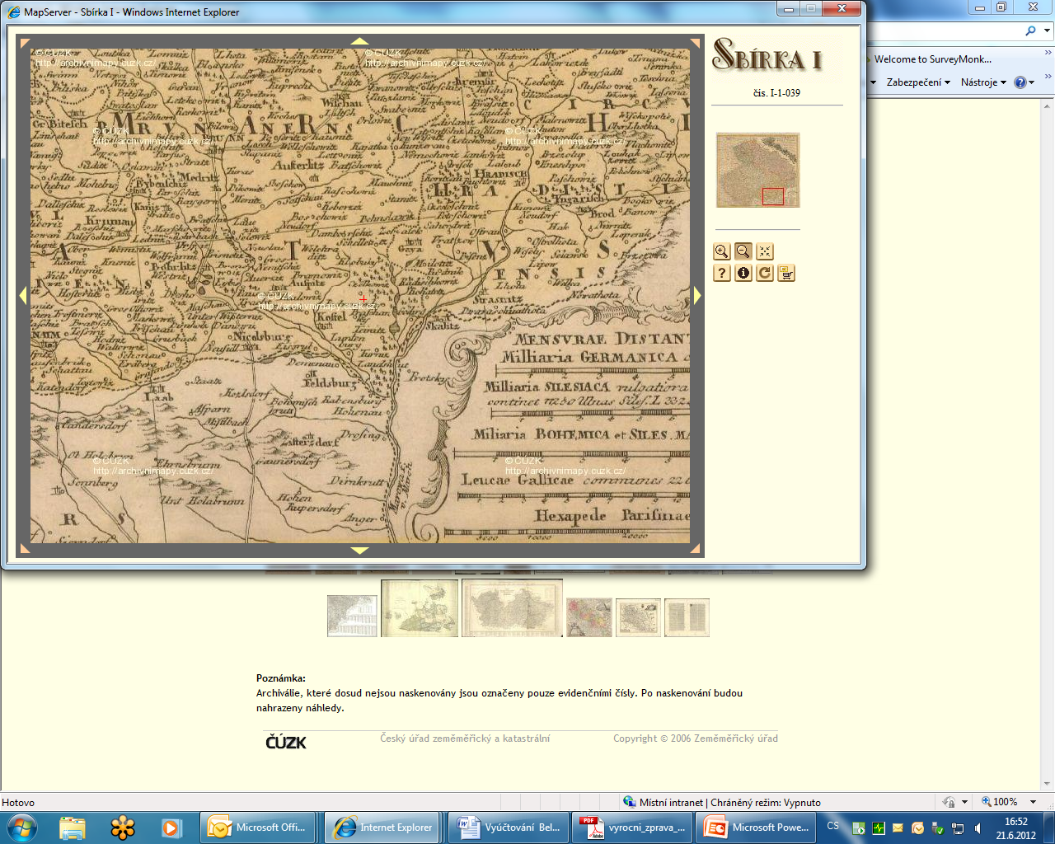
Too complex ?!?
The life never has been easy, but
Source: www.luminosity.com
human brains and their/our products can be improved step by step.

Slide 22





















Diversity of LMOs and their competences (ELF services as provided in autumn 2016)

